Slide 1
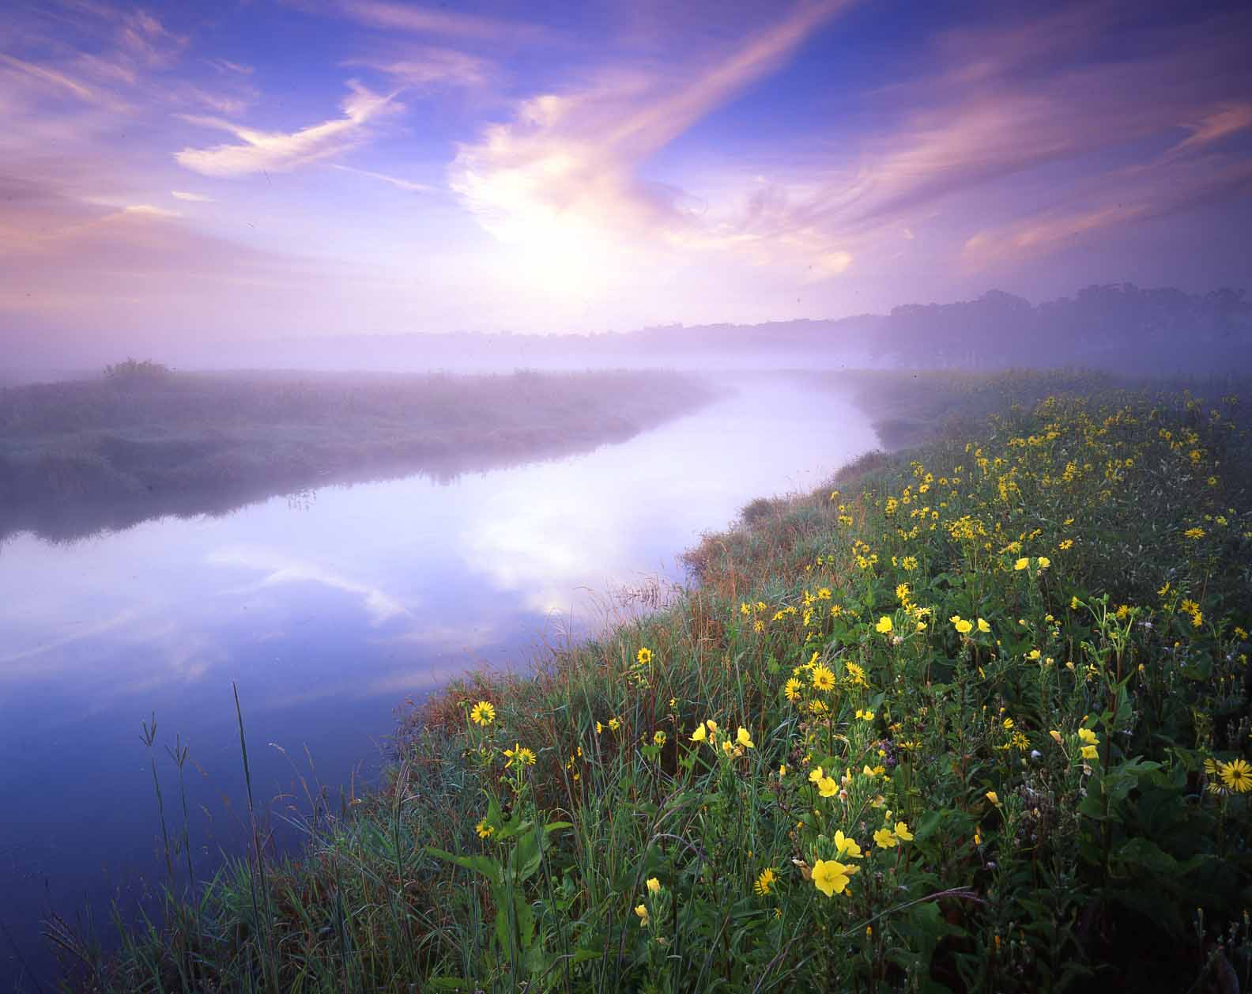
Hackmatack National Wildlife Refuge
PROGRESS UPDATE: THE POWER OF PARTNERS
May 10, 2016

Slide 2
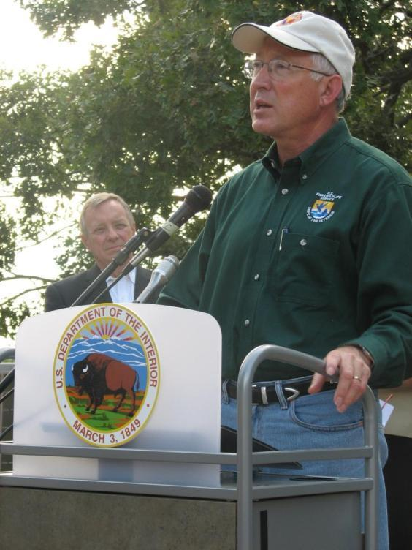
On August 15, 2012, Secretary of the Interior Ken Salazar announced the approval of Hackmatack NWR, the Nation’s 561st National Wildlife Refuge

Slide 3
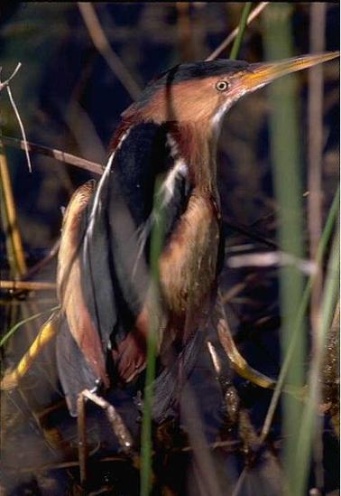
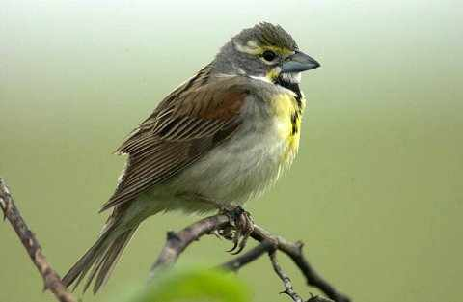
Goals of Hackmatack NWR
Protect wetlands and grasslands, and protect and enhance habitats for grassland-dependent and other migratory birds

Slide 4
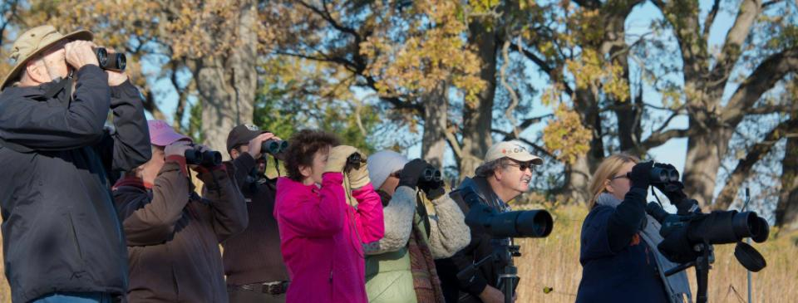
Goals of Hackmatack NWR
Create opportunities for hunting, fishing, wildlife observation and photography, and environmental education and interpretation

Slide 5
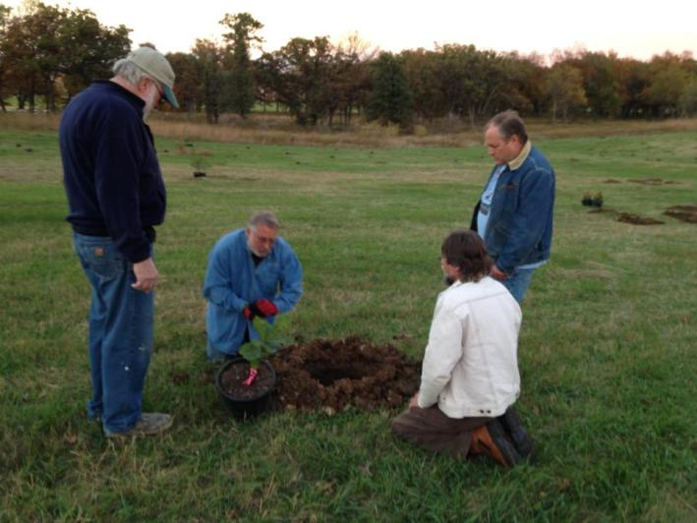
Goals of Hackmatack NWR
Promote science, education, and research to encourage responsible stewardship of our natural resources

Slide 6
Hackmatack Conservation Partnership
Land Protection Plan (2014-2017) and MOU
A collaborative, consensus-based, short-term land protection plan
Plan defines project selection parameters and land protection priority areas based on
USFWS-defined priorities for Hackmatack NWR
Recently updated through a February 2016 “mid-point check-in meeting” of partners and
others working in the greater Hackmatack region

Slide 7



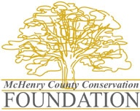
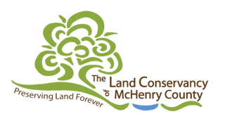


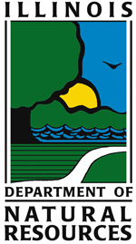

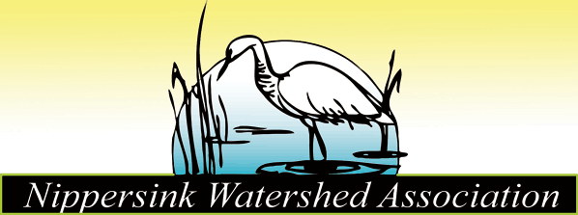
Hackmatack Conservation Partnership
Memorandum of Understanding
Six original partners, including USFWS, signed on to a corresponding MOU that defines roles of partnership members – and four new partners have signed on since 2014

Slide 8
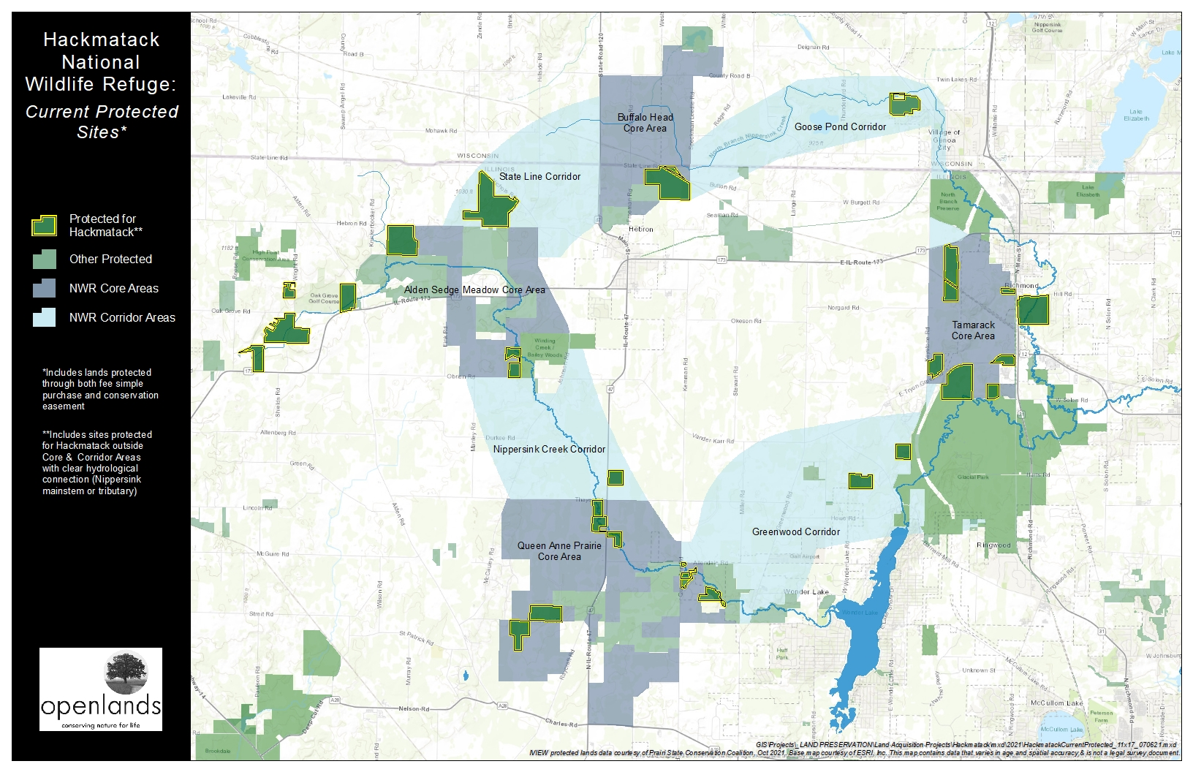
Land Protection Projects (Completed and Pending)
Partner efforts have protected 1,486.4 acres for Hackmatack = 13.3% of 11,193 acre goal

Slide 9
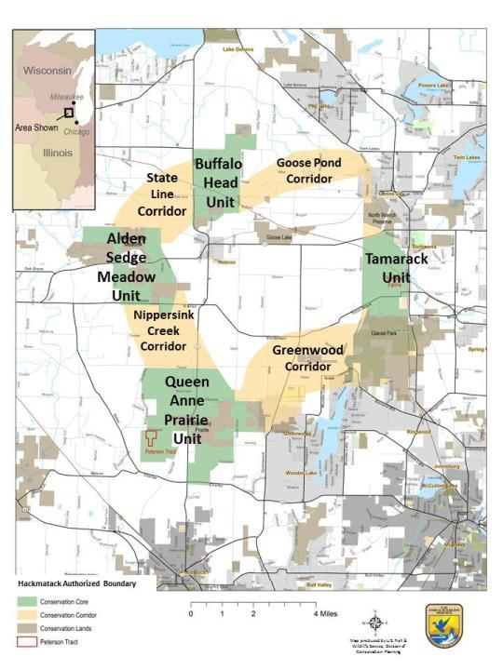
PROJECTS WITHIN:
Cores
Corridors
Areas outside cores, connected to Hackmatack through hydrology
Interactive Map

Slide 10
WORK IN CORES AND CORRIDORS

Slide 11
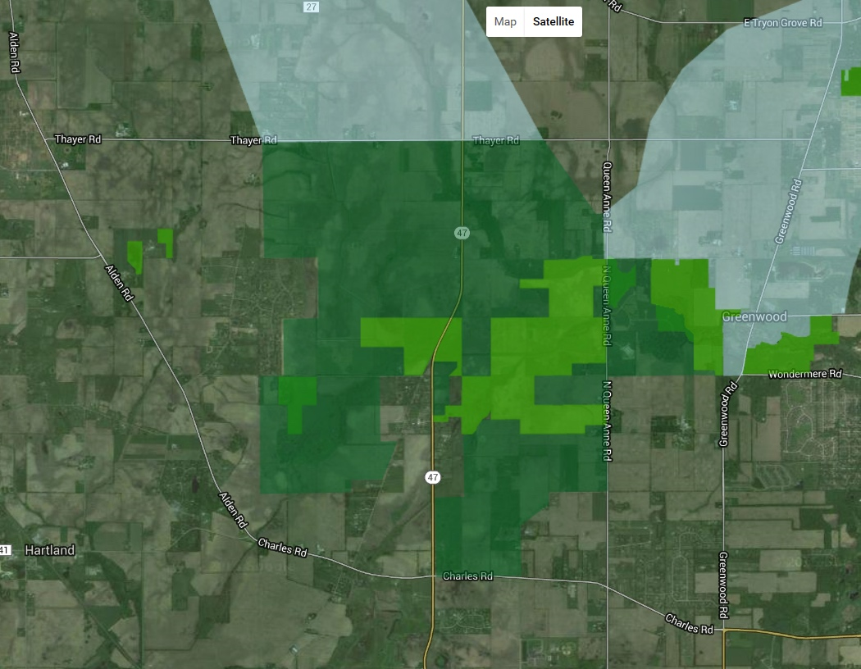
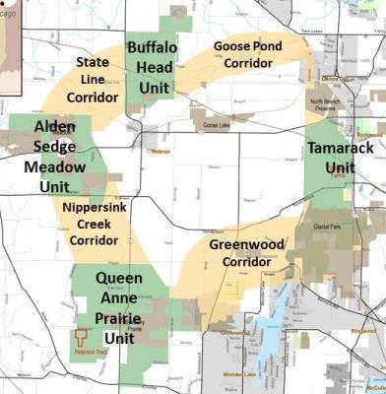
QUEEN ANNE PRAIRIE UNIT CORE AREA
Interactive Map

Slide 12
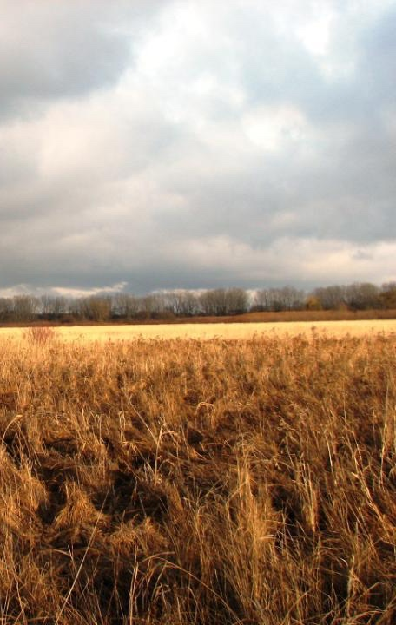
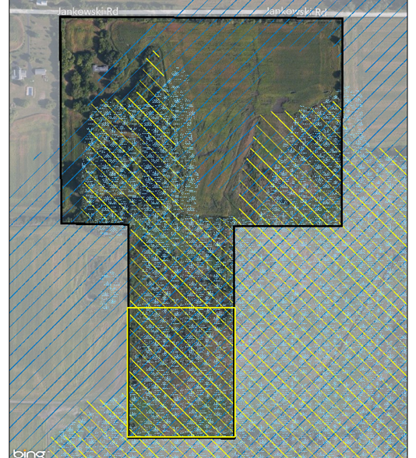
PETERSON (COMPLETED)
72 acres in Queen Anne Prairie Core (1st purchase)
Partners included McHenry County Conservation District, Openlands, State of Illinois, USFWS, with funding from
Illinois DNR, Openlands, McHenry County Conservation Foundation, Friends of Hackmatack NWR
KIEBLER
RICH

Slide 13
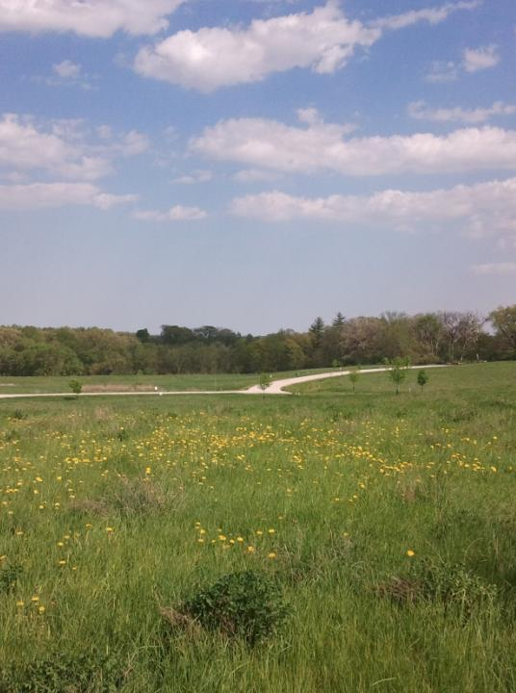
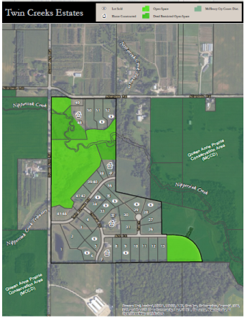
TWIN CREEKS (PARTIALLY COMPLETED)
105 acres in Queen Anne Prairie Core
Funding includes Openlands, MCCD,
private conservation buyers, Ducks
Unlimited, 319 Wetlands Grant
KIEBLER
RICH

Slide 14
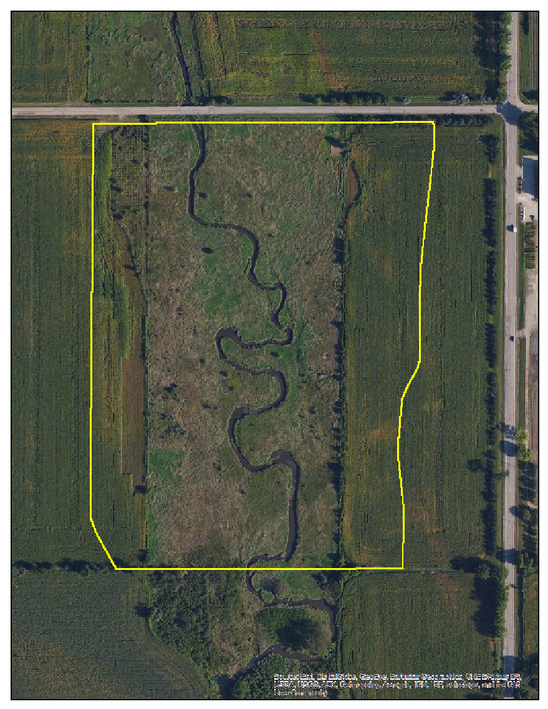
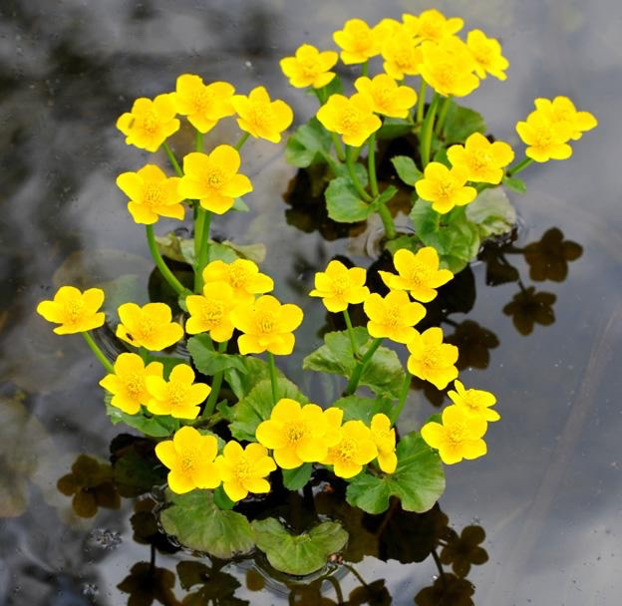
PERRICONE (COMPLETED)
27 acres in Queen Anne Prairie Core
Acquired by Openlands; facilitated by Nippersink Watershed Association
Contains about 0.4 miles of Nippersink Creek and remnant sedge meadow
THAYER RD
ROUTE 47

Slide 15
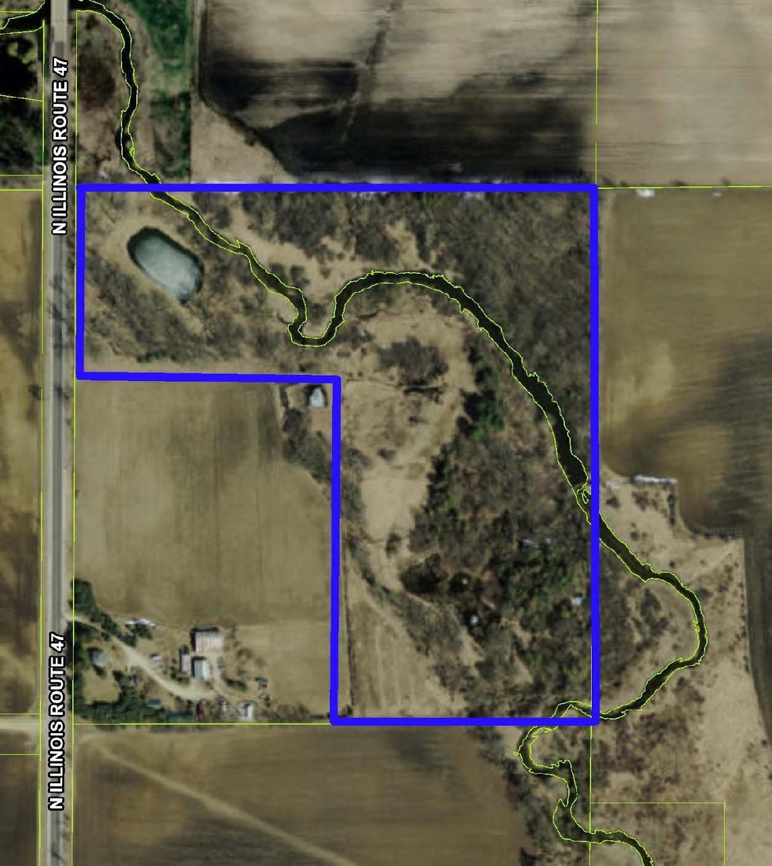
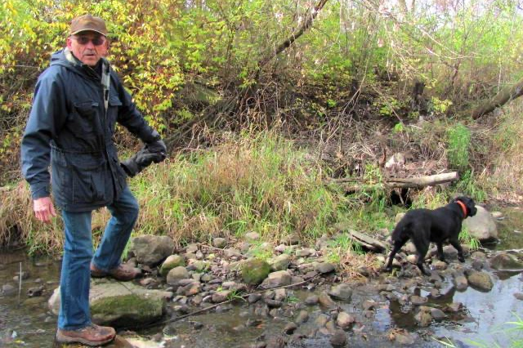
SHAW (COMPLETED)
26.3 acres in Queen Anne Prairie Core
Conservation easement donated to Land Conservancy of McHenry County
Contains sedge meadow, oak woods, savanna, and 0.3 miles of Nippersink Creek
Nippersink Watershed Association streambank stabilization project underway with IEPA 319 funding matched by TLC easement / Wonder Lake dredging
Dr. Lloyd Shaw with Mollie in the creek

Slide 16
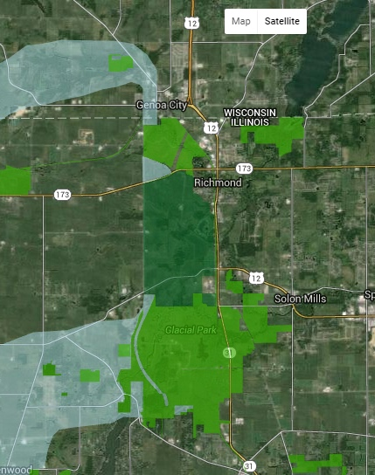
TAMARACK UNIT CORE AREA
Interactive Map

Slide 17
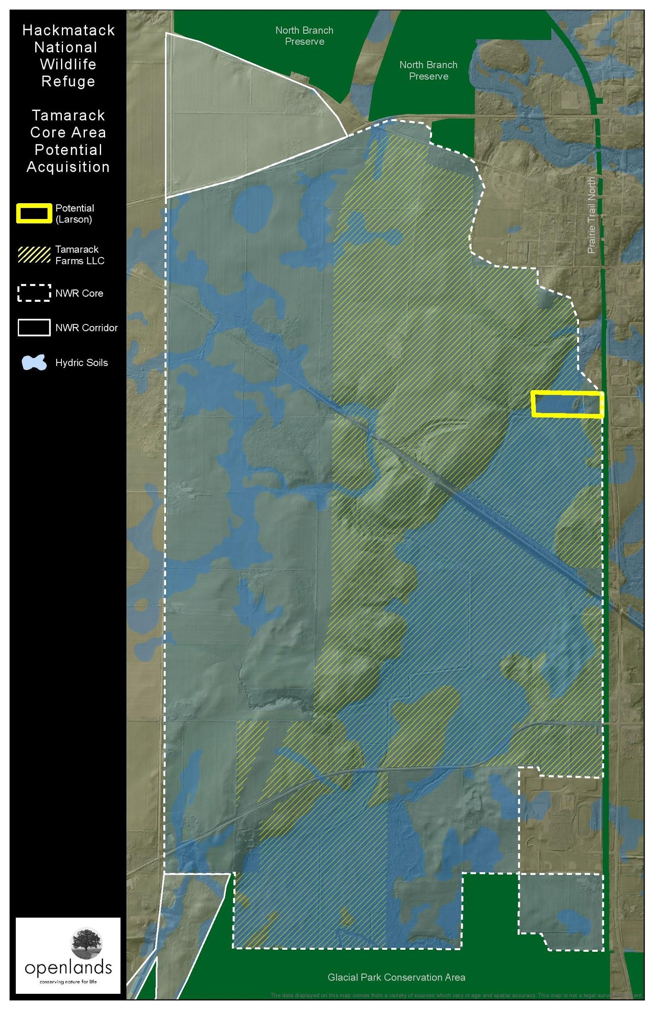
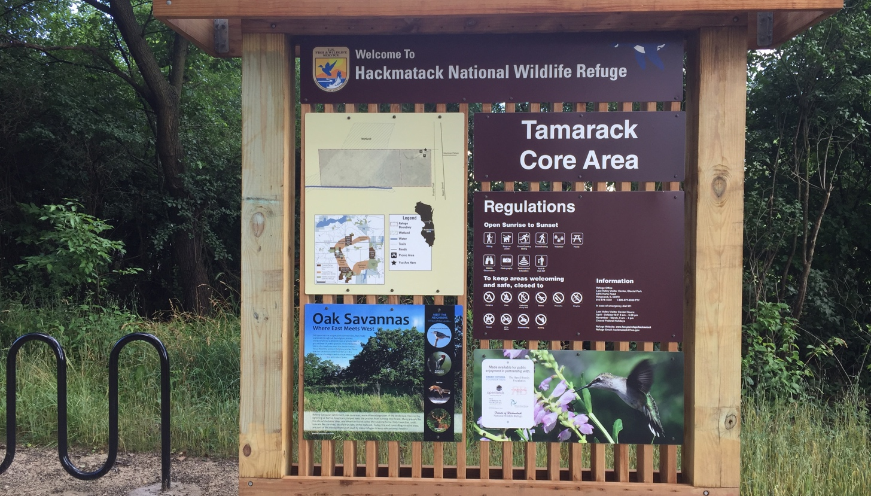
BLACKMON (COMPLETED)
11 acres in Tamarack Core
Hydrological connection to adjacent Tamarack Farms (Bell) property
Wetlands, oak savanna, and lots of restoration and public access potential (located along MCCD’s Prairie Trail bike path)

Slide 18
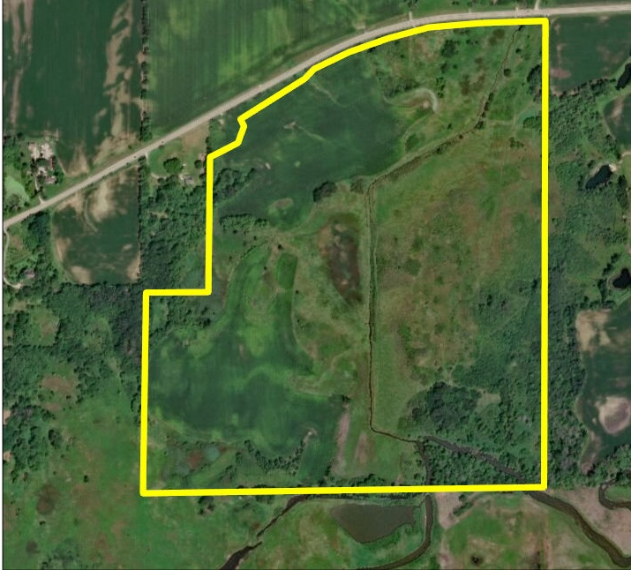
TAMARACK FARM SOUTH
(West Parcel)
159 acres in Tamarack Core
Contains wetlands, woodlands and sedge meadow. Borders the north side of Glacial Park.

Slide 19
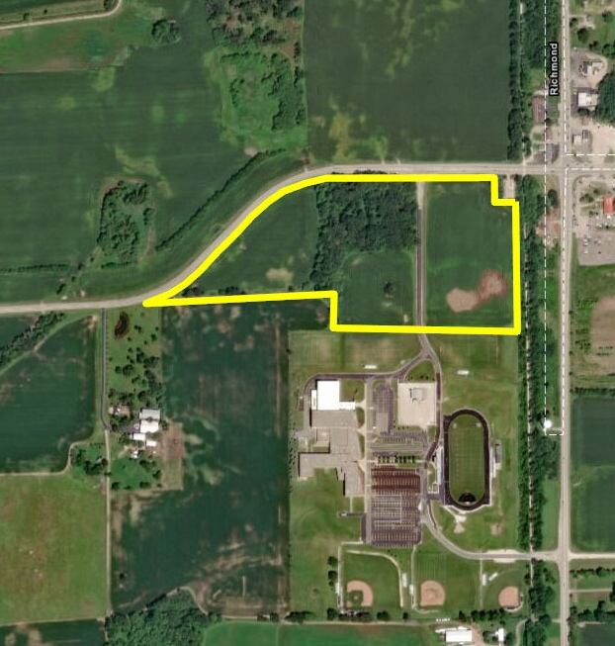
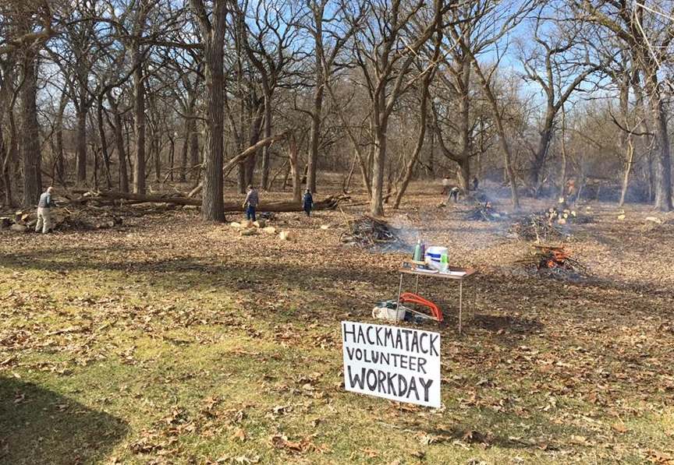
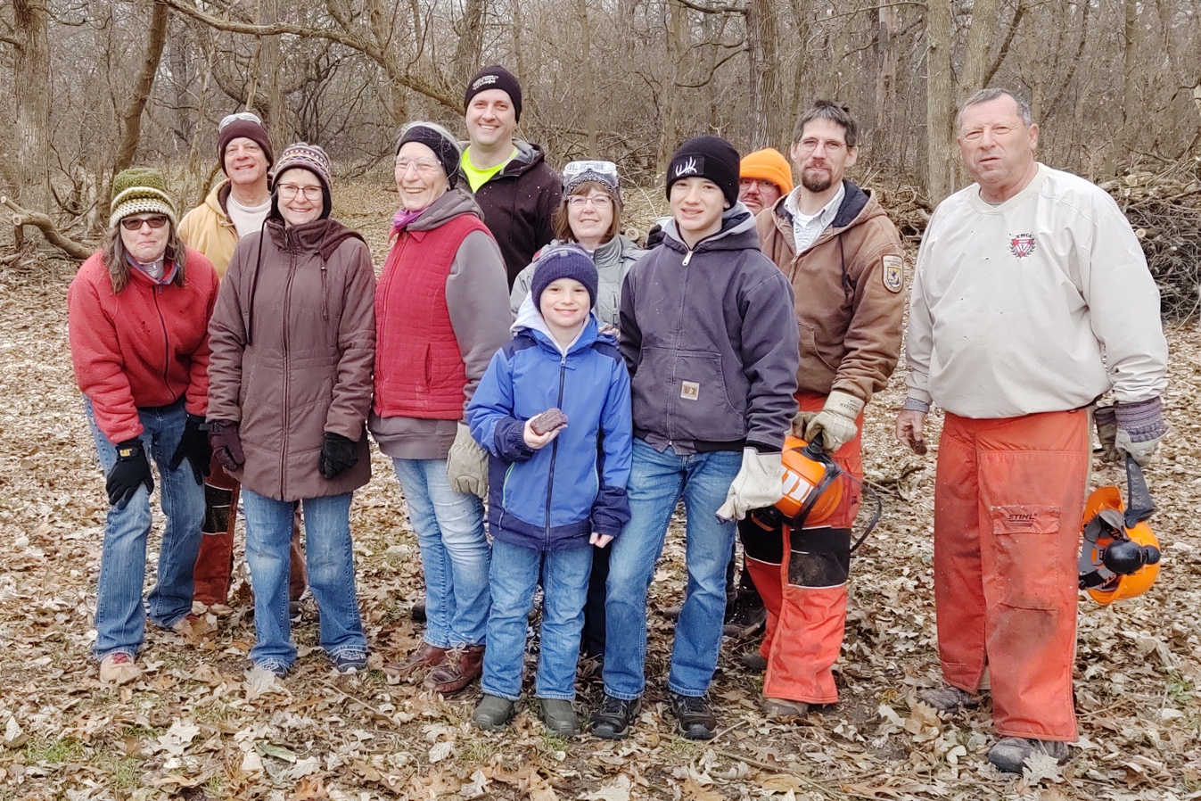
TAMARACK FARM SOUTH
(East Parcel)
29 acres in Tamarack Core
Contains oak woodland. Former ag fields planted with prairie seeds in 2020 with support from Partners, Du and MCCD. Friends held several workdays and has an ICE Challenge Grant. Borders the north side of Richmond Burton High School.

Slide 20
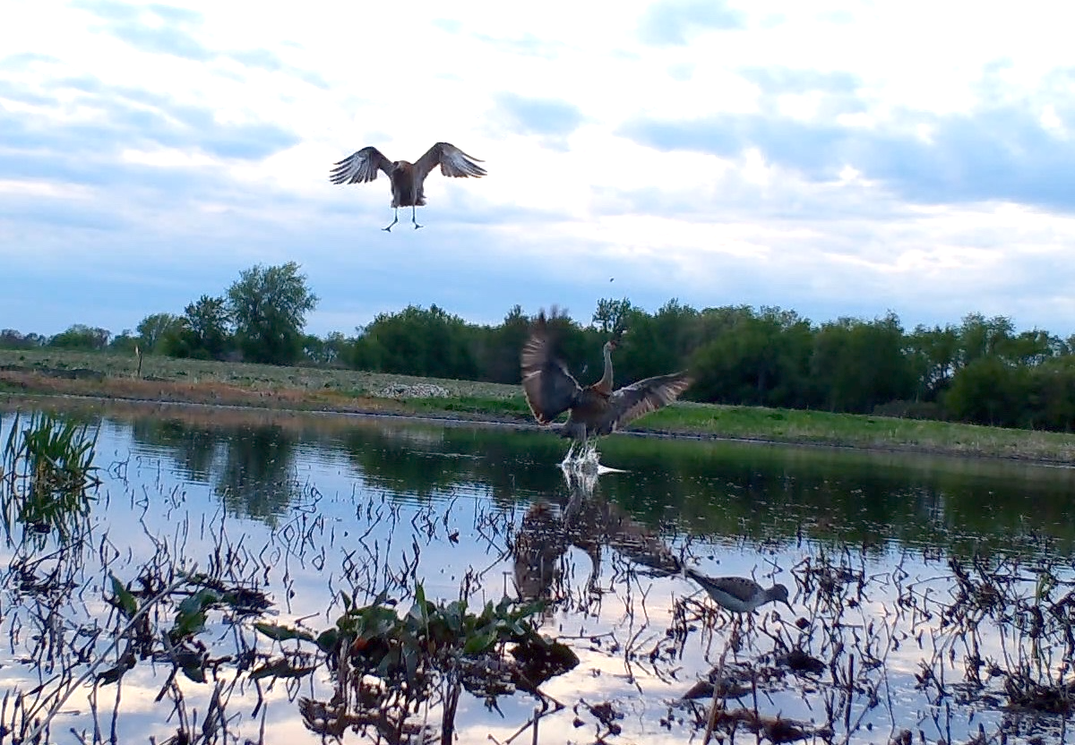
Powell 3
132 acres in Tamarack Core
Contains oak woodland, wetlands with springs. Drain tiles were removed south of the RR tracks. This is one of two sites receiving NAWCA funding.

Slide 21
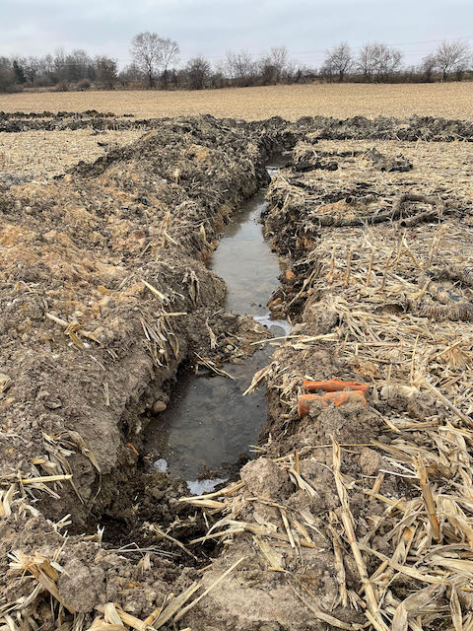
Tryon Grove
46 acres in Tamarack Core
Contains 0.33 miles of a Nippersink headwater stream and pond. The drain tiles have been removed.

Slide 22
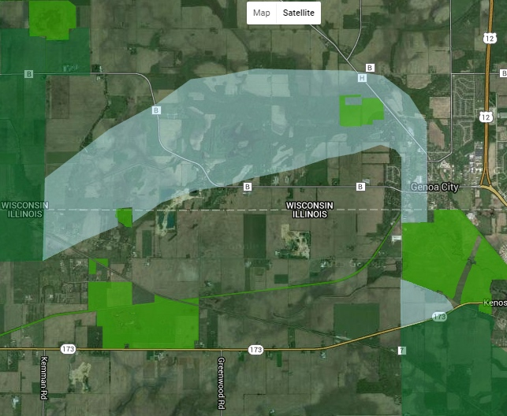
GOOSE POND CORRIDOR
Interactive Map

Slide 23
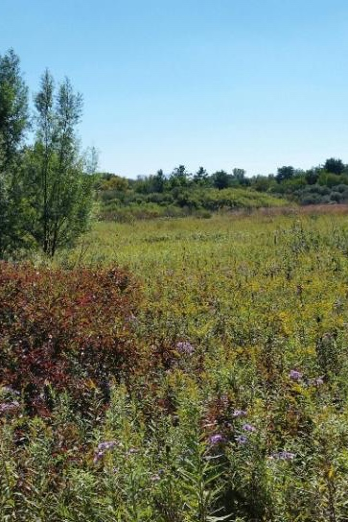
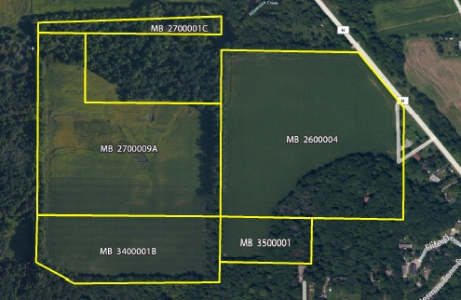
TURNER (COMPLETED)
86 acres in Goose Pond Corridor
Partners included Openlands, Ducks Unlimited
Funding included Ducks Unlimited, State of WI – DNR, Friends of Hackmatack NWR, private donors
KIEBLER
RICH

Slide 24
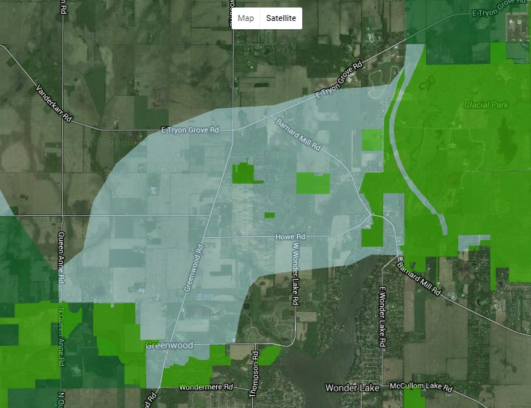
GREENWOOD CORRIDOR
Interactive Map

Slide 25
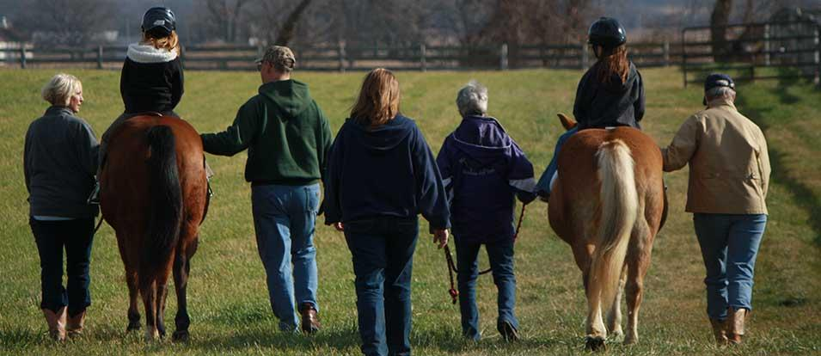
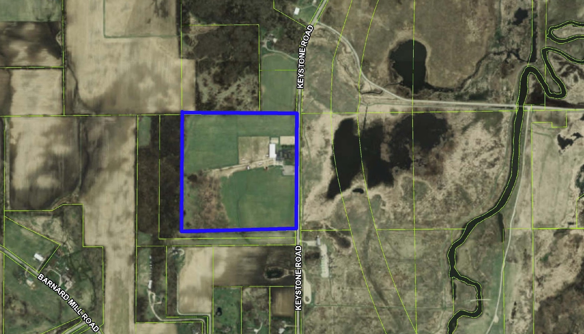
MAIN STAY (COMPLETED)
40 acre conservation easement donated to Land Conservancy of McHenry County by Main Stay Therapeutic Farm
Inside Greenwood Corridor, across the road from Glacial Park
One of Main Stay’s many therapeutic riding programs
GLACIAL PARK

Slide 26
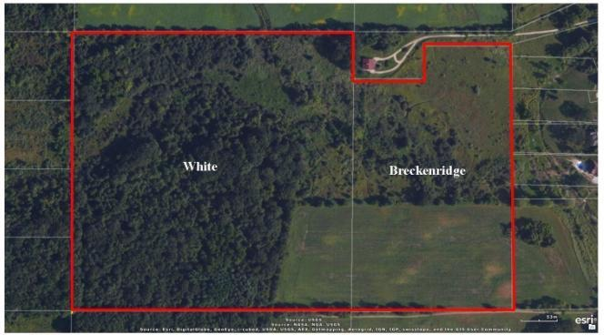
TRYON CREEK WOODS (COMPLETED)
About 59 acres in Greenwood Corridor
Acquired by MCCD with McHenry County Conservation Foundation funding (Breckenridge parcel) and Land Conservancy of McHenry County funding (White parcel)
KIEBLER
RICH

Slide 27
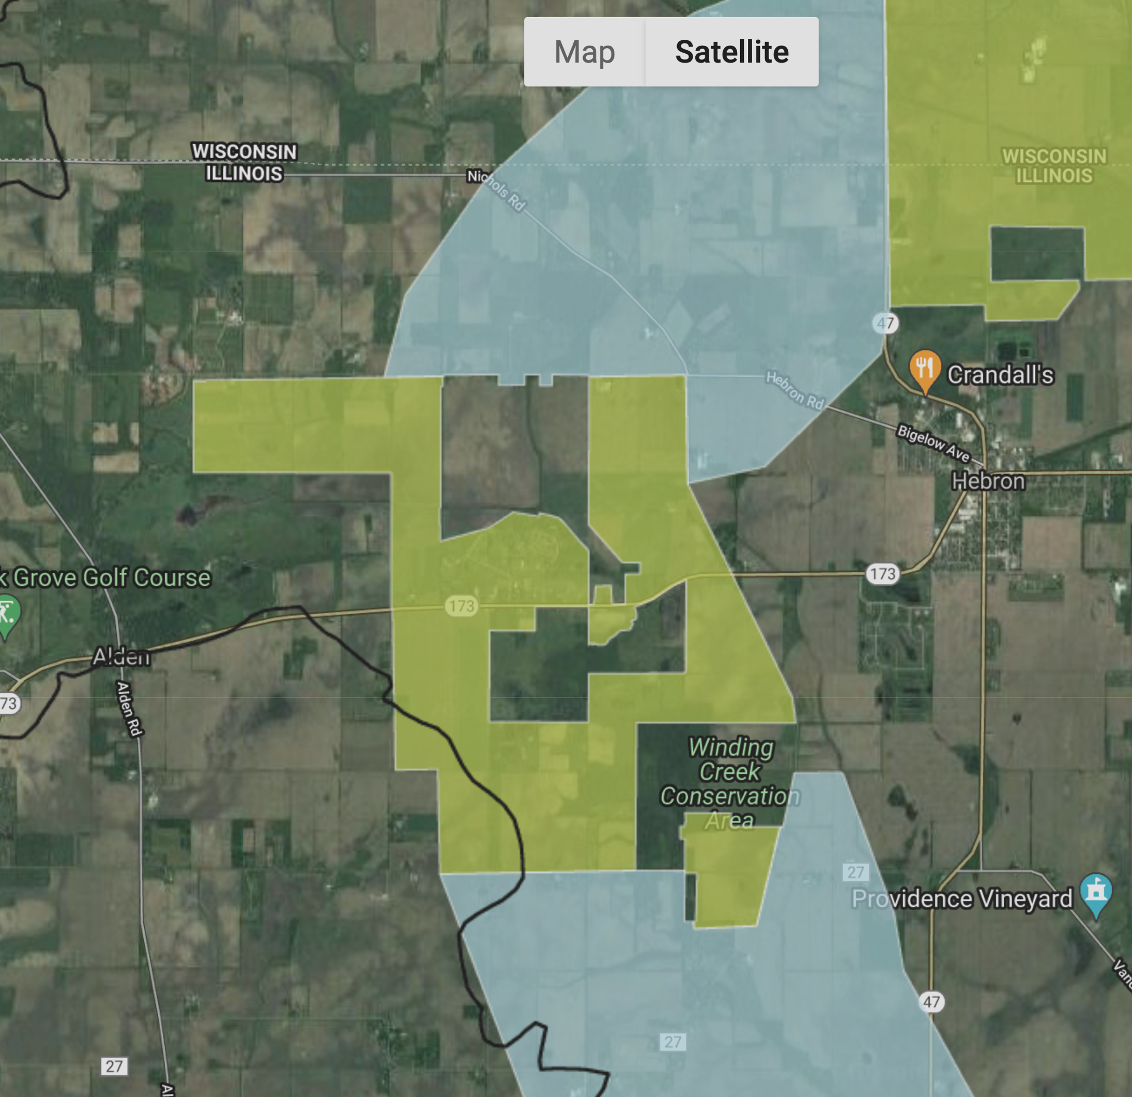
ALDEN SEDGE MEADOW CORE

Slide 28
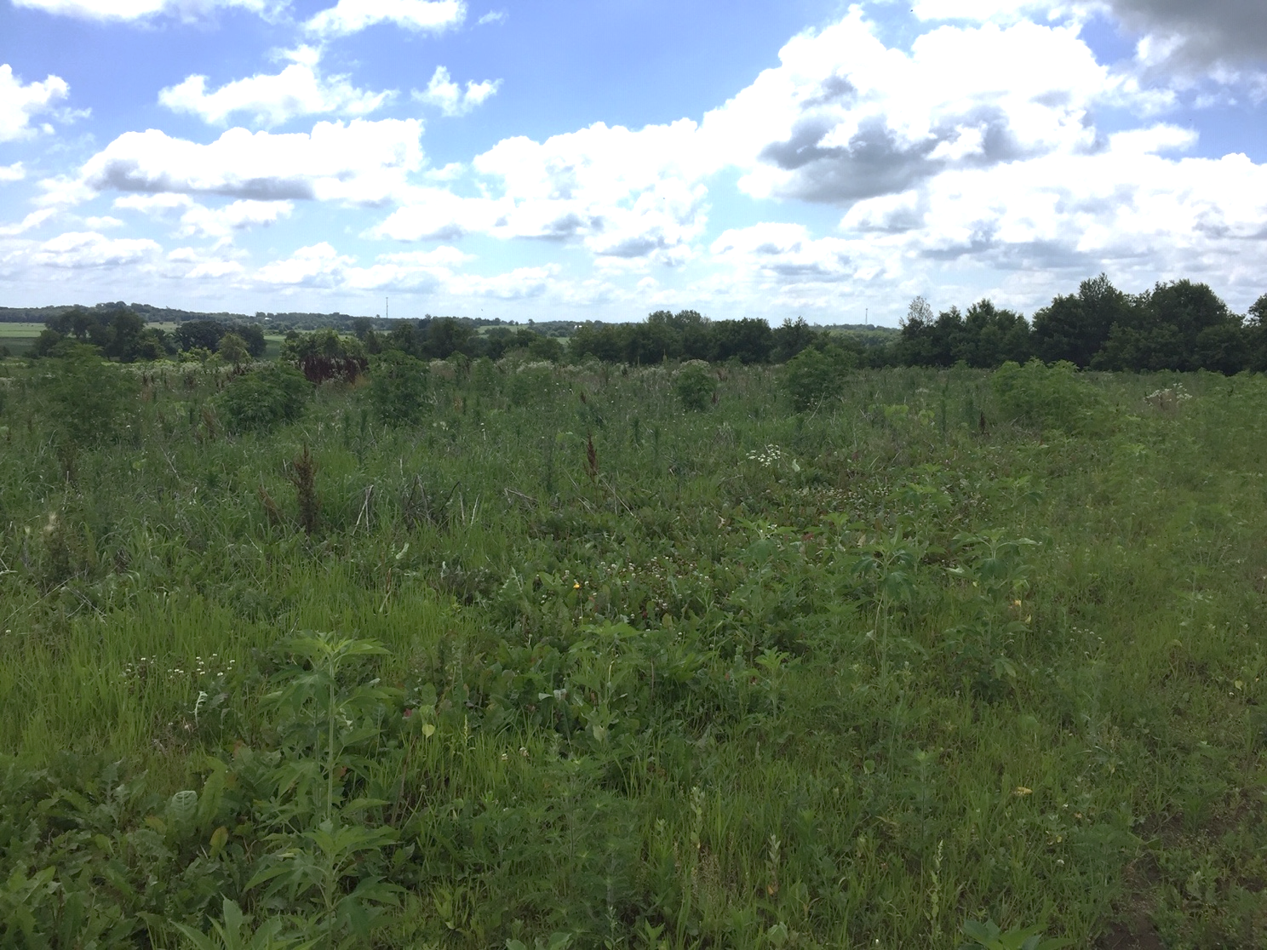
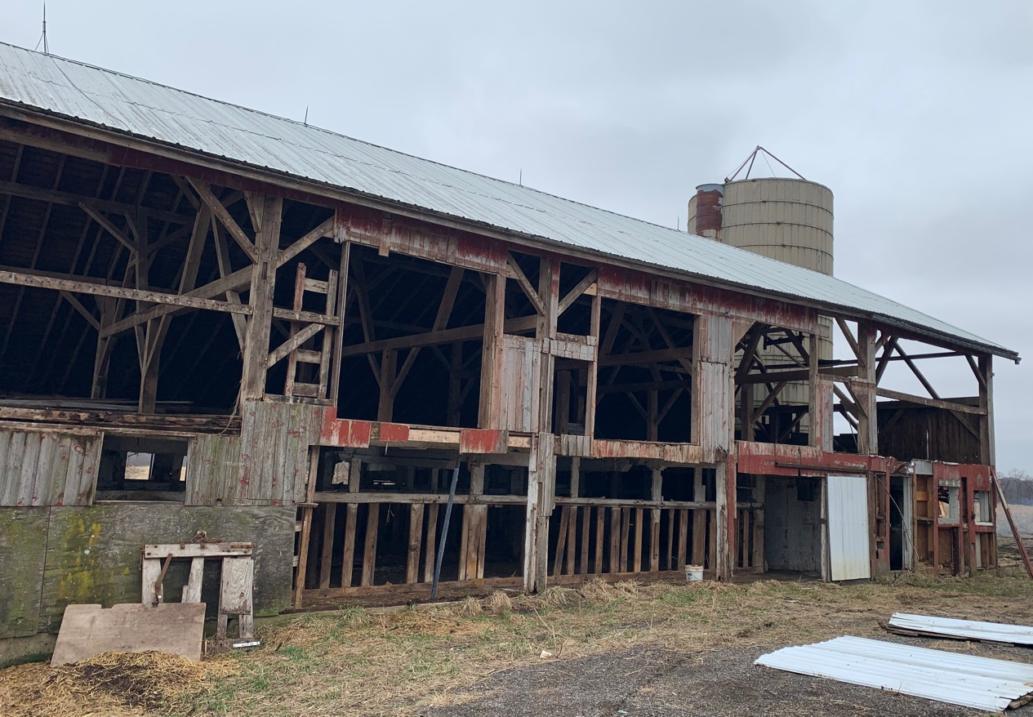
SPHAR
146 acres in Alden Sedge Meadow Core
Contains woodlands, wetlands. Borders the north side of Alden Sedge Meadow. This is one of two sites receiving NAWCA funding.

Slide 29
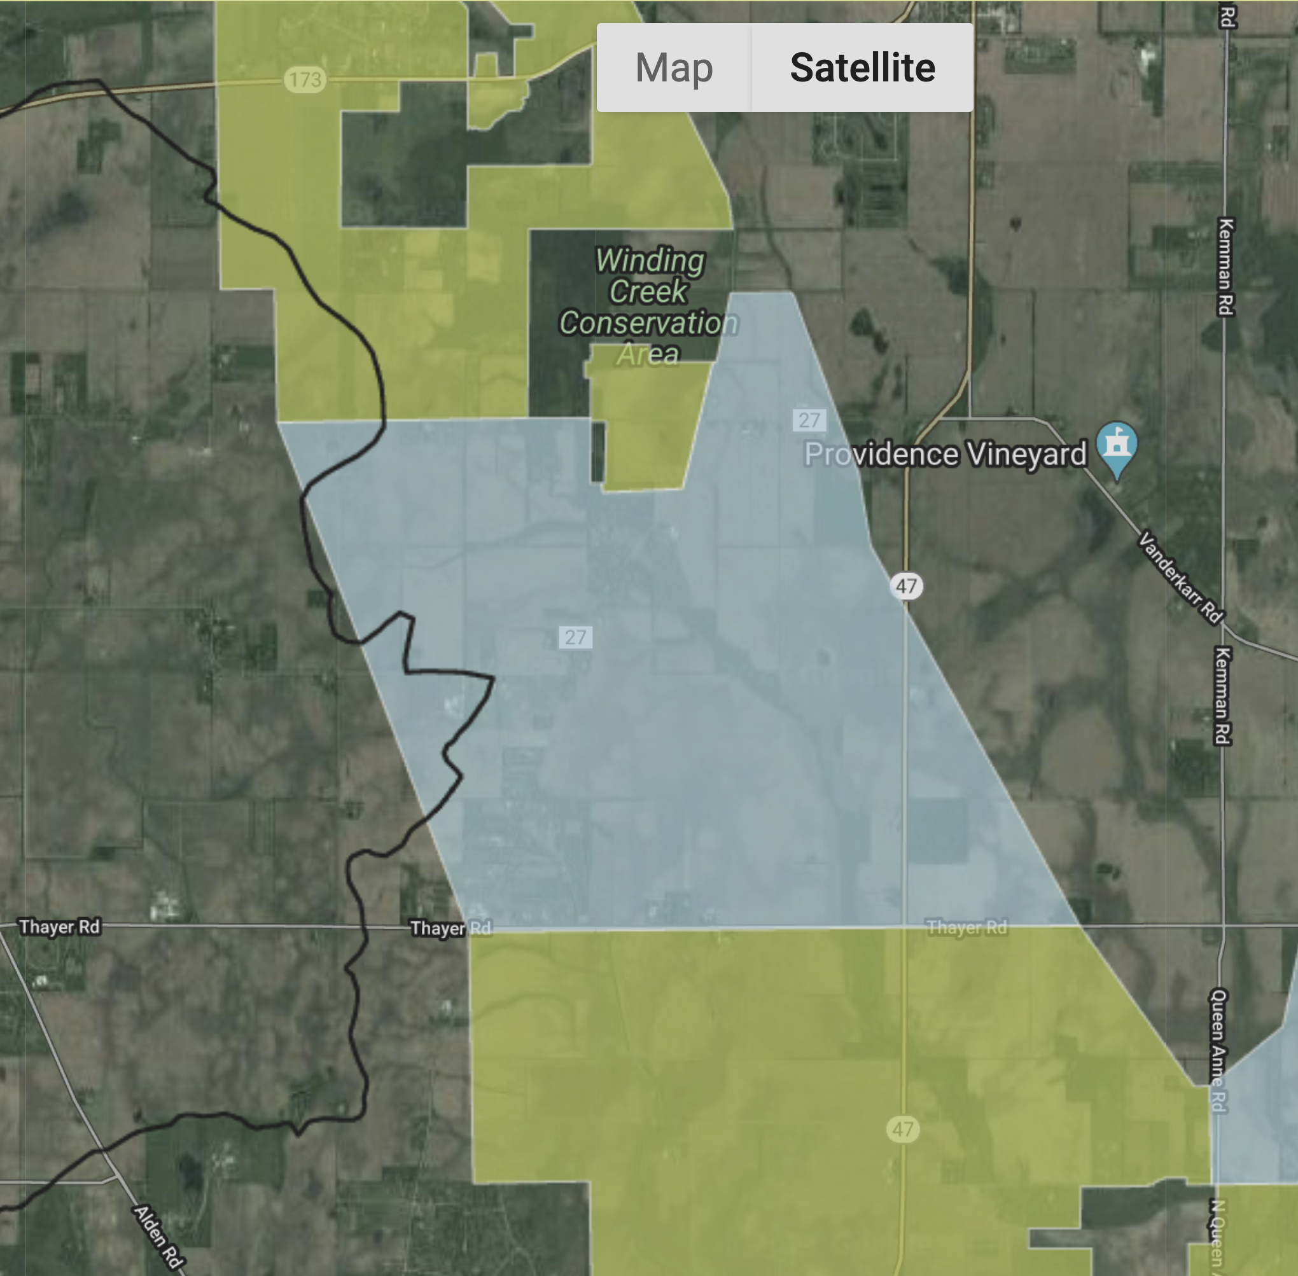
NIPPERSINK CREEK CORRIDOR

Slide 30
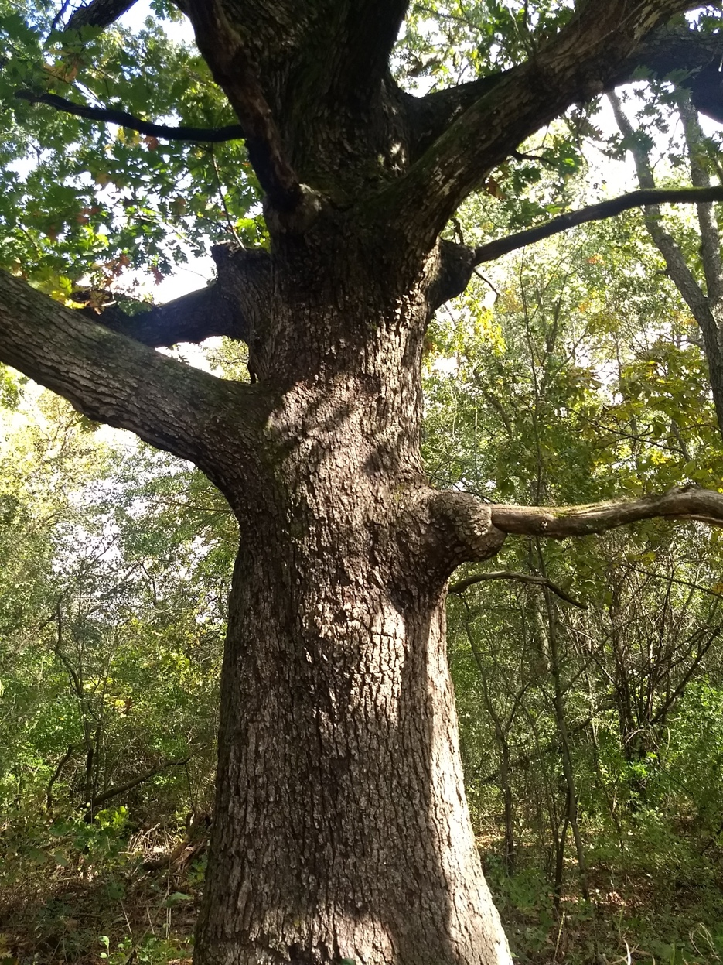
WEXLER & SANTOS
55 acres in Nippersink Creek Corridor
Contains woodland, 0.25 miles of Nippersink Creek and 0.2 miles of Nippersink Creek headwaters. Borders the west side of Winding Creek. Witness tree on site.

Slide 31
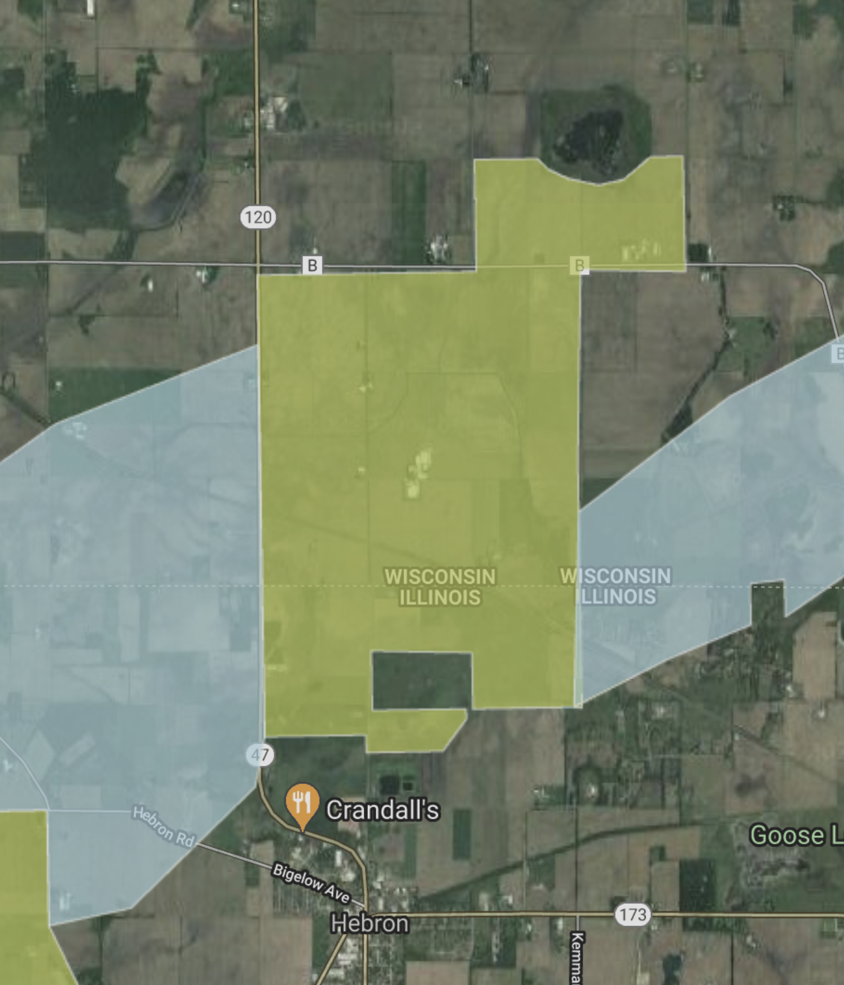
BUFFALO HEAD CORE

Slide 32
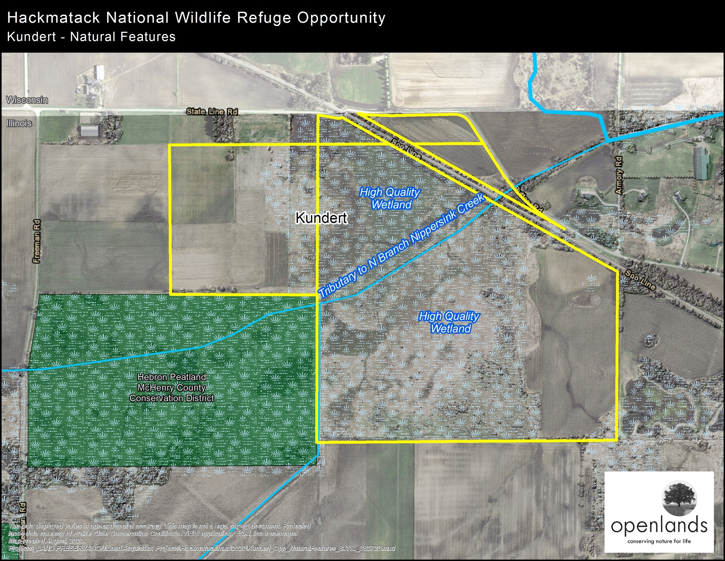
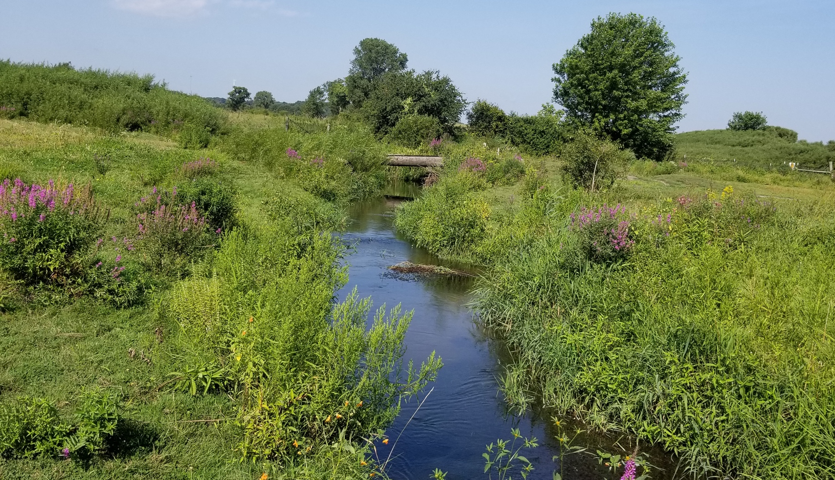
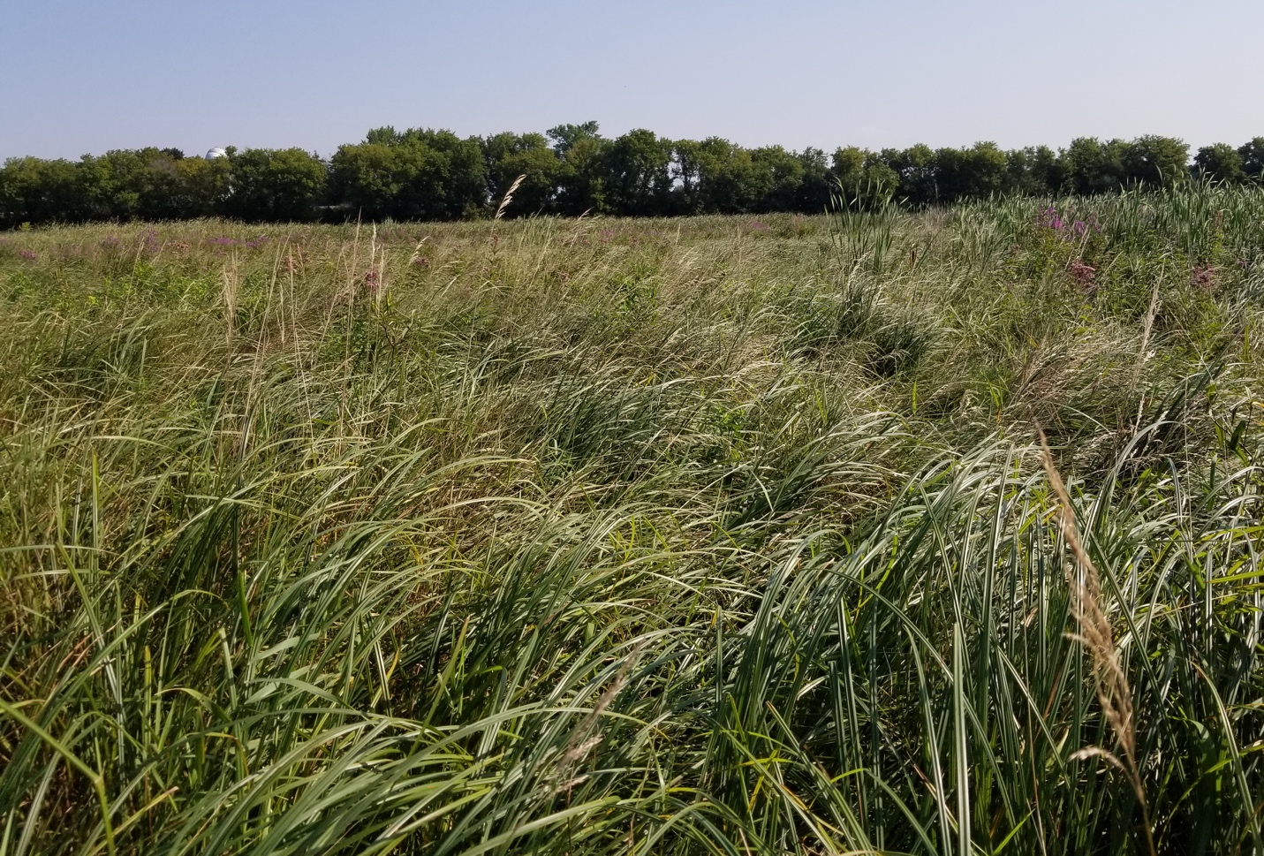
KUNDERT
181 acres in Buffalo Head Core
Contains wetlands with peat.
Borders the east side of an MCCD property.

Slide 33
WORK OUTSIDE CORES
WITH REFUGE IMPACTS
Interactive Map

Slide 34
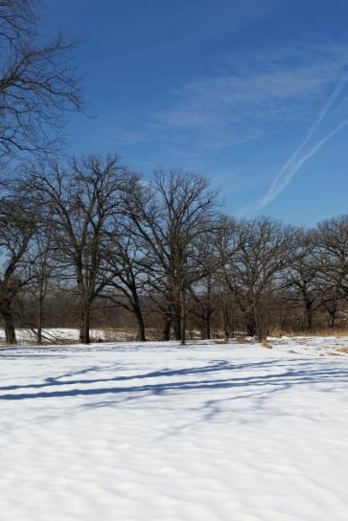
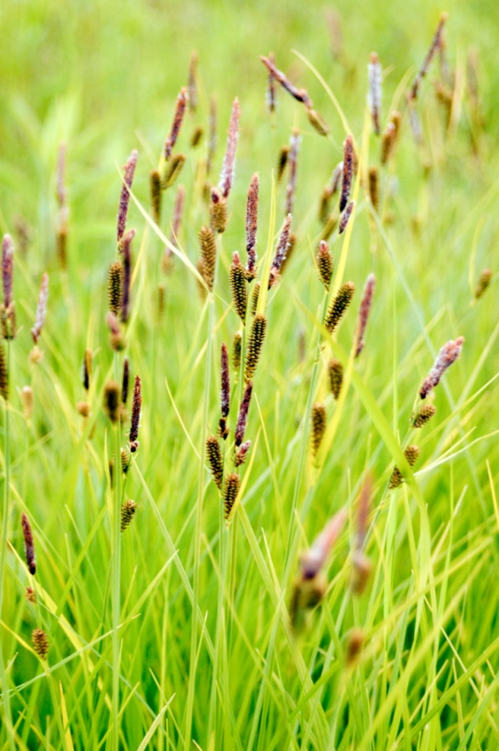
KEIBLER-RICH NATURAL AREA (COMPLETED)
84 acres with hydrological connection to
Hackmatack’s Alden Sedge Meadow Core Area, including Keibler (73 acre conservation
easement donation) and Rich (11 acre
acquisition)
Contains part of Alden Creek, a primary
feeder stream into the official headwaters
of the Nippersink Creek nearby
Protected habitats include riparian areas, sedge meadow, oak savanna
Partners included McHenry County Conservation District, Land Conservancy of McHenry County, Openlands, private landowners
RICH

Slide 35
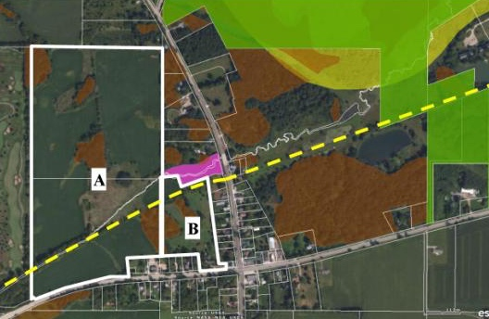

ALDEN SEDGE MEADOW
KIEBLER
RICH

Slide 36

MONASTERY MARSH (PENDING)
250+ acres with hydrological connection to Hackmatack’s Alden Sedge Meadow Core Area
Contains a mile of Alden Creek, a primary feeder stream into the official headwaters of the
Nippersink Creek nearby
Significant habitat restoration opportunities for wetland, prairie, oak savanna
Current partners include Ducks Unlimited, McHenry County Conservation District, Openlands, Illinois Audubon Society

Slide 37



Slide 38


HOFFMANN FARM / SPIEGELHOFF (PENDING)
153 acres with hydrological connection to Hackmatack’s Tamarack Core Area
Contains a section of the North Branch of Nippersink Creek
Significant sustainable farm operation, oak savanna restoration, and riparian corridor protection opportunities
Current partners include Openlands, Land Conservancy of McHenry County, private landowner

Slide 39



Slide 40


SILVER CREEK MARSH (PENDING)
Hydrological connection to Hackmatack’s Queen Anne Prairie Core Area
Contains McHenry County’s largest unprotected wetland complex
Current partners include Land Conservancy of
McHenry County and Nippersink Watershed Association
Land Conservancy of McHenry County is spearheading fundraising efforts to protect wetlands, currently at $500,000 raised
$400,000 in IEPA 319 funds for restoration is in the works from Nippersink Watershed Association

Slide 41


QUEEN ANNE PRAIRIE CORE AREA

Slide 42

Federal Funding
Request to Senator Durbin for $25 million in USFWS funding

Slide 43




Tamarack Boundary 2014

Slide 44

Insert Bell property photos and map from Steve

Slide 45

Insert Bell property photos and map from Steve

Slide 46
PARTNER OUTREACH AND EDUCATION WORK

Slide 47



The Friends, USFWS, McHenry County Conservation District, IL DNR, Sierra Club IL, City of Lake Geneva Four Seasons Nature Preserve

Slide 48





The Big Sit
The Friends, USFWS, MCCD,
McHenry County Audubon, IL Sierra Club

Slide 49




IN SEARCH OF EAGLES DAY
The Friends, USFWS, Sierra Club IL, MCCD, IL DNR, McHenry County Audubon, Towns of Algonquin, Carpentersville, IL and Burlington, WI

Slide 50

Inspiring Connections Outdoors
The Friends, Sierra Club IL, MCCD, Friends of Big Foot Beach State Park, Clear Water Outdoor, WI DNR, Pritzker College Prep

Slide 51


Slide 52



Friends of Hackmatack & PARTNERS!
Monarch Work
2015-16

Slide 53



The Friends of Hackmatack Monarch Committee
Friends of Hackmatack NWR
US Fish & Wildlife Service – Refuge Division & Chicago Field Office
McHenry County Conservation District
Environmental Defenders of McHenry County
Sierra Club, Illinois Chapter
Crystal Lake Park District
Creative Arts, INC
McSEEP – McHenry Co. Superintendent of Schools Enviro. Ed. Program
Loyola University Retreat & Ecology Center, Woodstock
Wildflower Propagation and Preservation Committee
Ancient Oaks Foundation
Sustainability Center, McHenry County College
Conservation @ Home - The Land Conservancy
McHenry County Fair Board
Kettle Moraine Land Trust
Brookwood Middle School, Genoa City WI
Citizens Climate Lobby, McHenry
BeeKeepers, McHenry Co
IDOT & City of Woodstock

Slide 54




YCC
Now in its
Third Year!
A collaboration between MCCD
and USFWS

Slide 55




RESTORATION WORKDAYS
Private Landowners, Openlands, Ducks Unlimited, MCCD, IL DNR, Sierra Club, IL Nature Preserves Commission, Land Conservancy of McHenry County, and Volunteers

Slide 56

OUTREACH
Migratory Bird Days, Monarch Initiative, Eagle Days, The Big Sit, Inspiring Connections Outdoors, Quarterly Friends Gatherings, Nature Center/Library displays, Website, Facebook, Twitter!
1300 +
Partners
30+

Slide 57


